Slide 1
Lecture 23-24
Relational Database Design

Slide 2
Outline
Data Redundancy and Update Anomalies
Insertion Anomalies
Deletion Anomalies
Modification Anomalies
Functional Dependencies
Characteristics of Functional Dependencies
Identifying Functional Dependencies
Identifying the Primary Key for a Relation
Using Functional Dependencies

Slide 3
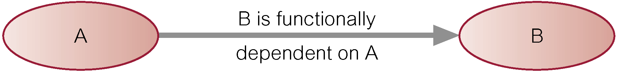
Characteristics of Functional Dependencies
Functional dependency describes relationship between attributes.
For example, if A and B are attributes of relation R, B is functionally dependent on A (denoted A → B), if each value of A in R is associated with exactly one value of B in R.
Diagrammatic representation.
The determinant of a functional dependency refers to the attribute or group of attributes on the left-hand side of the arrow.
© Pearson Education Limited 1995, 2005

Slide 4
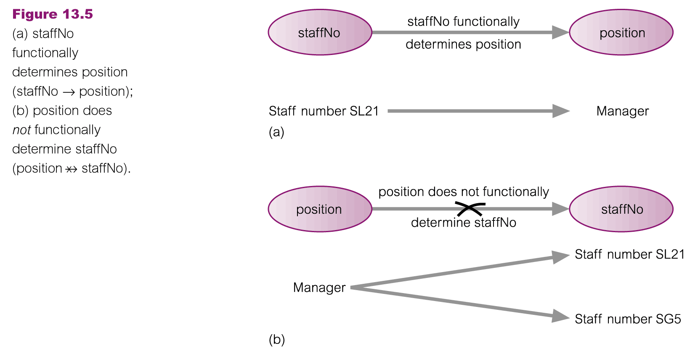
An Example Functional Dependency
© Pearson Education Limited 1995, 2005

Slide 5
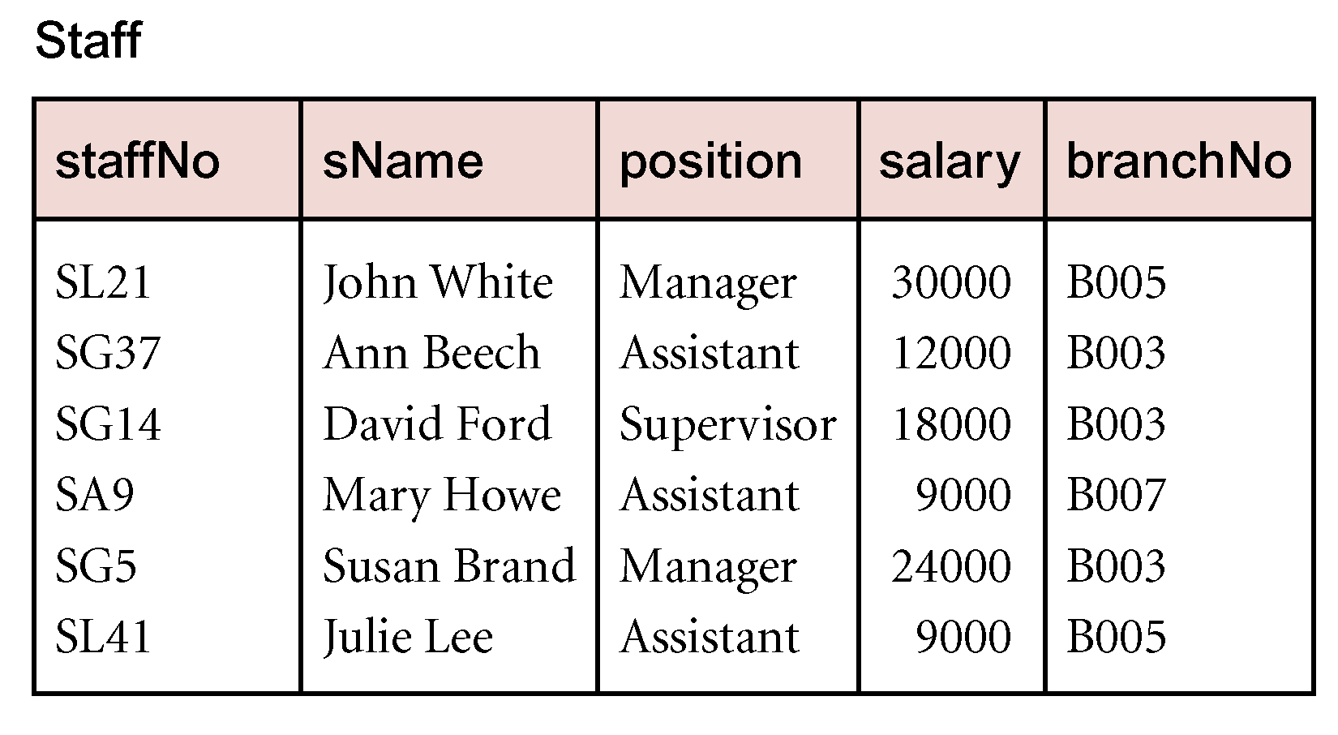
Example Functional Dependency that holds for all Time
Consider the values shown in staffNo and sName attributes of the Staff relation
Based on sample data, the following functional dependencies appear to hold.
staffNo → sName
sName → staffNo
© Pearson Education Limited 1995, 2005

Slide 6
Example Functional Dependency that holds for all Time
However, the only functional dependency that remains true for all possible values for the staffNo and sName attributes of the Staff relation is:
staffNo → sName
© Pearson Education Limited 1995, 2005

Slide 7
Characteristics of Functional Dependencies
Determinants should have the minimal number of attributes necessary to maintain the functional dependency with the attribute(s) on the right hand-side.
This requirement is called full functional dependency.
© Pearson Education Limited 1995, 2005

Slide 8
Full Functional Dependency
Full functional dependency indicates that if A and B are attributes of a relation, B is fully functionally dependent on A, if B is functionally dependent on A, but not on any proper subset of A.
© Pearson Education Limited 1995, 2005

Slide 9
Example Full Functional Dependency
Exists in the Staff relation
staffNo, sName → branchNo
True - each value of (staffNo, sName) is associated with a single value of branchNo.
However, branchNo is also functionally dependent on a subset of (staffNo, sName), namely staffNo. Example above is a partial dependency.
© Pearson Education Limited 1995, 2005

Slide 10
Transitive Dependencies
Important to recognize a transitive dependency because its existence in a relation can potentially cause update anomalies.
Transitive dependency describes a condition where A, B, and C are attributes of a relation such that if A → B and B → C, then C is transitively dependent on A via B (provided that A is not functionally dependent on B or C).
OR
A transitive dependency occurs when one non-prime attribute is dependent on another non-prime attribute.
© Pearson Education Limited 1995, 2005

Slide 11
Example Transitive Dependency
Consider functional dependencies in the StaffBranch relation
staffNo → sName, position, salary, branchNo
branchNo → bAddress
Transitive dependency, staffNo → bAddress exists via branchNo.
© Pearson Education Limited 1995, 2005

Slide 12
Functional Dependencies (Cont.)
Trivial − If a functional dependency (FD) X → Y holds, where Y is a subset of X, then it is called a trivial FD. Trivial FDs always hold.
Non-trivial − If a FD X → Y holds, where Y is not a subset of X, then it is called a non-trivial FD.
Completely non-trivial − If an FD X → Y holds, where x intersect Y = Φ, it is said to be a completely non-trivial FD.

Slide 13
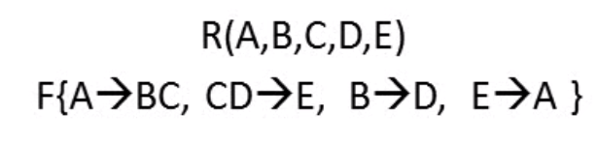
Closure of a Set of Functional Dependencies
Given a set F of functional dependencies, there are certain other functional dependencies that are logically implied by F.
For example: If A → B and B → C, then we can infer that A → C
The set of all functional dependencies logically implied by F is the closure of F.
We denote the closure of F by F⁺.
F⁺ is a superset of F.

Slide 14
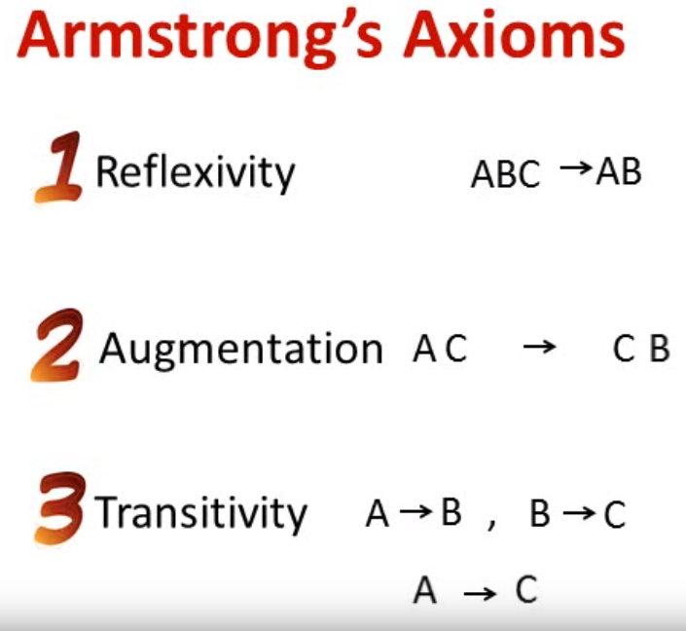
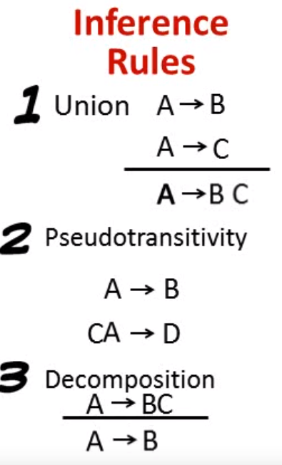
Inference Rules
Armstrong’s axioms are a set of inference rules used to infer all the other functional dependencies on a relational database. They were developed by William W. Armstrong.

Slide 15


Axiom of reflexivity: This axiom says, if Y is a subset of X, then X determines Y
Axiom of augmentation: The axiom of augmentation, also known as a partial dependency, says if X determines Y, then XZ determines YZ for any Z
Axiom of transitivity: The axiom of transitivity says if X determines Y, and Y determines Z, then X must also determine Z

Slide 16
Union: Union rule says, if X determines Y and X determines Z, then X must also determine Y and Z.
If X → Y and X → Z then X → YZ
Decomposition Rule: This Rule says, if X determines Y and Z, then X determines Y and X determines Z separately.
If X → YZ then X → Y and X → Z
Pseudo transitive Rule: In Pseudo transitive Rule, if X determines Y and YZ determines W, then XZ determines W.
If X → Y and YZ → W then XZ → W

Slide 17
Closure of Attribute Sets
Given a set of attributes α, define the closure of α under F (denoted by α⁺) as the set of attributes that are functionally determined by α under F
Algorithm to compute α⁺, the closure of α under F
result := α; while (changes to result) do for each β → γ in F do begin if β ⊆ result then result := result ∪ γ end

Slide 18
Example of Attribute Set Closure
(AG)⁺
1. result = AG
2. result = ABCG (A → C and A → B)
3. result = ABCGH (CG → H and CG ⊆ AGBC)
4. result = ABCGHI (CG → I and CG ⊆ AGBCH)
Is AG a candidate key?
Is AG a super key?
Does AG → R? == Is (AG)⁺ ⊇ R
Is any subset of AG a superkey?
Does A → R? == Is (A)⁺ ⊇ R
Does G → R? == Is (G)⁺ ⊇ R
R = (A, B, C, G, H, I) F = { A → B
A → C CG → H CG → I B → H}

Slide 19
Identifying Functional Dependencies
Identifying all functional dependencies between a set of attributes is relatively simple if the meaning of each attribute and the relationships between the attributes are well understood.
This information should be provided by the enterprise in the form of discussions with users and/or documentation such as the users’ requirements specification.
However, if the users are unavailable for consultation and/or the documentation is incomplete then depending on the database application it may be necessary for the database designer to use their common sense and/or experience to provide the missing information.
© Pearson Education Limited 1995, 2005

Slide 20
Example - Using sample data to identify functional dependencies.
Consider the data for attributes denoted A, B, C, D, and E in the Sample relation
Important to establish that sample data values shown in relation are representative of all possible values that can be held by attributes A, B, C, D, and E. Assume true despite the relatively small amount of data shown in this relation.
© Pearson Education Limited 1995, 2005

Slide 21
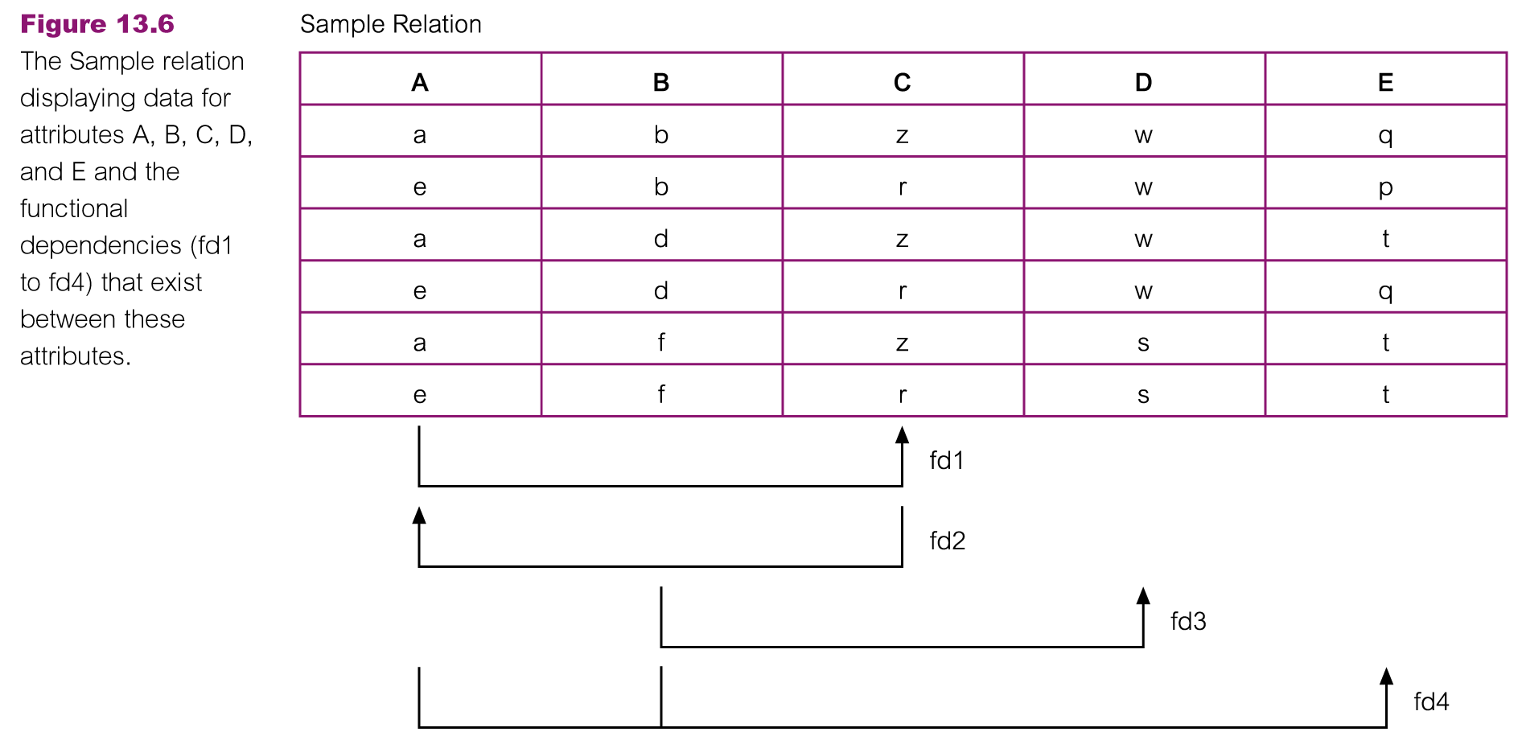
Example - Using sample data to identify functional dependencies.
© Pearson Education Limited 1995, 2005

Slide 22
Example - Using sample data to identify functional dependencies.
© Pearson Education Limited 1995, 2005

Slide 23
Example - Using sample data to identify functional dependencies.
Function dependencies between attributes A to E in the Sample relation.
A → C (fd1)
C → A (fd2)
B → D (fd3)
A, B → E (fd4)
© Pearson Education Limited 1995, 2005

Slide 24
Identifying the Primary Key for a Relation using Functional Dependencies
Main purpose of identifying a set of functional dependencies for a relation is to specify the set of integrity constraints that must hold on a relation.
An important integrity constraint to consider first is the identification of candidate keys, one of which is selected to be the primary key for the relation.
© Pearson Education Limited 1995, 2005

Slide 25
Example - Identifying Primary Key for Sample Relation
Sample relation has four functional dependencies.
The determinants in the Sample relation are A, B, C, and (A, B). However, the only determinant that functionally determines all the other attributes of the relation is (A, B).
(A, B) is identified as the primary key for this relation.
© Pearson Education Limited 1995, 2005

Slide 26
Suggested Reading
Chapter 14 of Database Systems: A Practical Approach to Design, Implementation, and Management by Thomas Conolly 6th Edition
Chapter 8 of Database System Concepts by Abraham Silberschatz

Slide 27
References
https://www.db-book.com/db6/slide-dir/index.html
https://www.pearson.com/us/higher-education/product/Connolly-Powerpoint-Slides-for-Database-Systems

